Slide 1
BLOOD BANK APP
MADE BY –
CHHAYANK TYAGI CS-A(2000290120059)
HANU AGARWAL CS-A(2000290120067)
KHUSHI CS-C(2100290129005)

Slide 2
AIM OF THE PROJECT
In health care services, blood donation is a complex process and consumes time to find some donor who has the compatibility of blood group with the patient.
We developed android based blood donation application as blood bank solutions to establish a connection between the requester and donor at anytime and anywhere.
The objective of this application is to provide the information about the requested blood and number of available donors around those localities.
The purpose of this study was to develop a blood management information system to assist in the management of blood donor records and ease/or control the distribution of blood in various parts of the country basing on the hospital demands.
Without quick and timely access to donor records, creating market strategies for blood donation, lobbying and sensitization of blood donors becomes very difficult.
The blood management information system offers functionalities to quick access to donor records collected from various parts of the country.

Slide 3
OBJECTIVE OF THIS PROJECT
Helps Blood Banks to find blood donor and depository online.
Encourages blood donors to donate.
Helps people find blood donors in times of need.

Slide 4

SOFTWARE AND HARDWARE REQUIREMENTS
HARDWARE REQUIREMENTS:
Processor : intel pentium iv 1.8 ghz
Motherboard : intel 915gvsr chipset board
Ram : 1 gb ddr2 ram
Hard disk drive : 160 gb
SOFTWARE REQUIREMENTS:
Android Studio , Firebase
LANGUAGES:
Java
XML
ANDROID TOOLS:
Android Emulator
xampp-win32-5.5.19-0-VC11
Android SDK - adt-bundle-windows-x86

Slide 5
EXISTING SYSTEM
The purpose of Blood bank data abstract of project study was to develop a blood management information system to assist in the management of blood donor records and ease/or control the distribution of blood in various parts of the country basing on the hospital demands.
Without quick and timely access to donor records
It creating market strategies for blood donation, lobbying and sensitization of blood donors becomes very difficult.

Slide 6
DISADVANTAGES OF EXISTING SYSTEM
In existing system, without integrating the blood banks will lead to time consuming while searching of a group of blood.
It having proper information it is very difficult to supply to blood to the required people.
Information sharing is not possible among blood banks, hospitals about the required blood group in the case of urgency.

Slide 7
PROPOSED SYSTEM
The blood management information system offers functionality to quick access to donor records collected from various parts of the country.
It enables monitoring of the results and performance of the blood donation activity such that relevant and measurable objectives of the organization can be checked.
It provides to management timely, confidential and secure medical reports that facilitates planning and decision making and hence improved medical service delivery.
The reports generated by the system give answers to most of the challenges management faces as far as blood donor records are concerned.

Slide 8
ADVANTAGES OF PROPOSED SYSTEM
The people in need of blood can search for the donors by giving their blood group and city name. It saves time as he can search donors online without going anywhere.
Using this system user can get blood in time and can save his relative or friend life. Our website work 24x7 so user can get information of blood donor any time.
Blood donor can also get registered and save life of other person. The main benefit of this system is the information of available blood group.
When blood is need in the operation then people have very less time to get the blood available so if he get the information like who can give him blood in time in his city is lifesaving.
And here our system work, whenever a person need blood he get information of the person who has the same blood group he needs.

Slide 9
MODULE LIST
USER/DONOR
Login
Register
Post Blood Donation
Update/Delete Donation
Search Donor
Search Hospital Donation

Slide 10
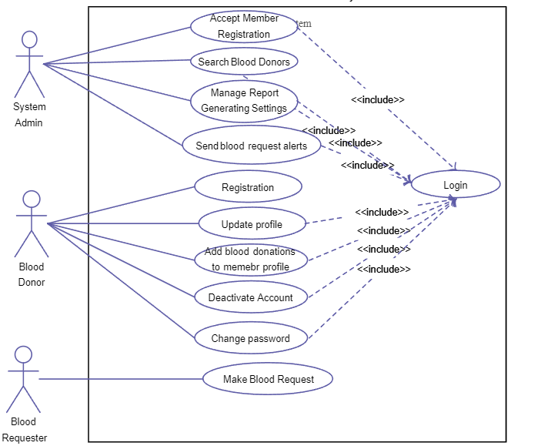
DIAGRAMS
USECASE DIAGRAMS

Slide 11
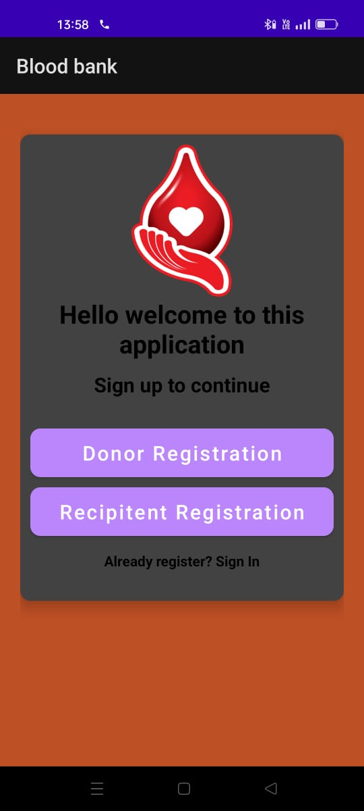
HOME PAGE

Slide 12
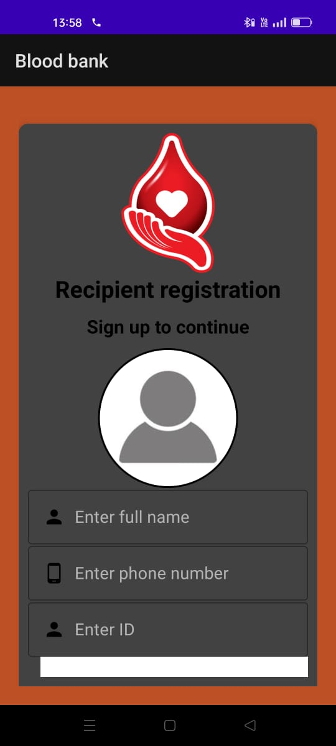
RECIPIENT REGISTRATION

Slide 13
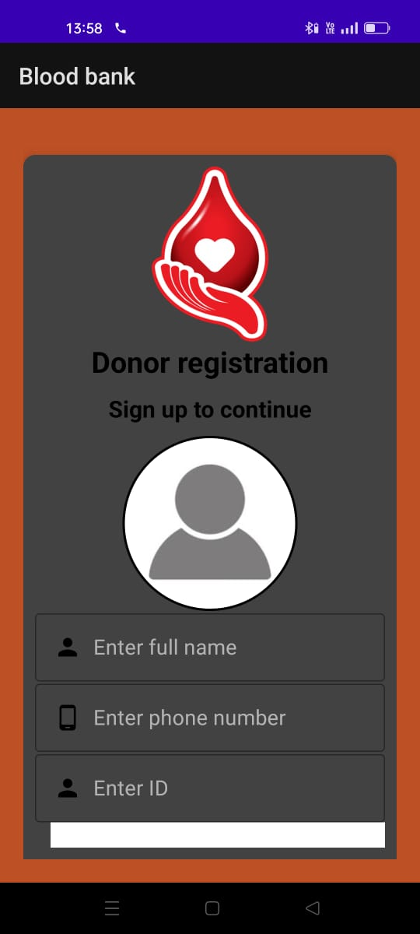
DONOR REGISTRATION

Slide 14
CONCLUSION
So it will be reduced time consuming for users. It is fully easy system using web application “Blood Donor Recruitment”.
Earlier systems are fully maintained manually by records. But now users can view availability for anywhere anytime through this website.
The proposed System can be used to reduce the time required to deliver required blood to needy in cases of emergency.
This application provides a way of communication and synchronization between the hospital and the blood banks.

Slide 15
FUTURE ENHANCEMENT
In Future work, This application to develop a cross platforms like IOS, etc.
In adding the more features of blood management system to develop access with user’s flexibility.
To authenticate the users based on the system users list which is maintained by the operating system.
To restrict the usage of all files by the users based on their privileges on the system

Slide 16
REFERNECES
[1] N. Adarsh, J. Arpitha, M. D. Ali, N. M. Charan, and P. G.Mahendrakar.Effective blood bank management based on rfid in real time systems.In Embedded Systems (ICES), 2014 InternationalConference on, pages 287–290. IEEE, 2014.
[2] L. Bos and K. Donnelly.Snomed-ct: The advanced terminology and coding system for ehealth. Stud Health Technol Inform, 121:279–290, 2006.
[3] E. Ekanayaka and C. Wimaladharma. Blood bank management system. Technical Session-Computer Science and Technology & IndustrialInformation Technology, page 7, 2015.
[4] L. T. Goodnough, M. E. Brecher, M. H. Kanter, and J. P. AuBuchon.Transfusionmedicineblood transfusion.New EnglandJournal of Medicine, 340(6):438–447, 1999.
[5] D. M. Harmening. Modern blood banking and transfusion practices.FA Davis, 2012

